Slide 1
Where Have All the Babies Gone?
Group 2
Carol Le
Andy Kim
Kumar Rishu
Nace Weigand
Prem Charan Badri

Slide 2
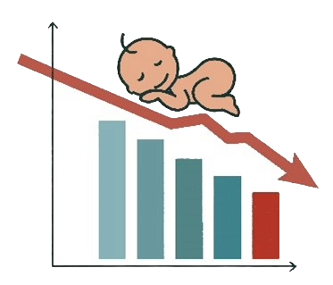
Project Outline
01
Project Goals
Data Collection
Exploratory Data Analysis
Solutions & Insights
QnA
02
03
04
05
Notes:
Andy
Prem
1. Data Collection: Strategic Sourcing
2. Initial Data Cleaning and Filtering
3. Feature Engineering: Preparing the Data
Exp - Nace
Solutions
Models - Carol
Insights and solutions - Kumar

Slide 3
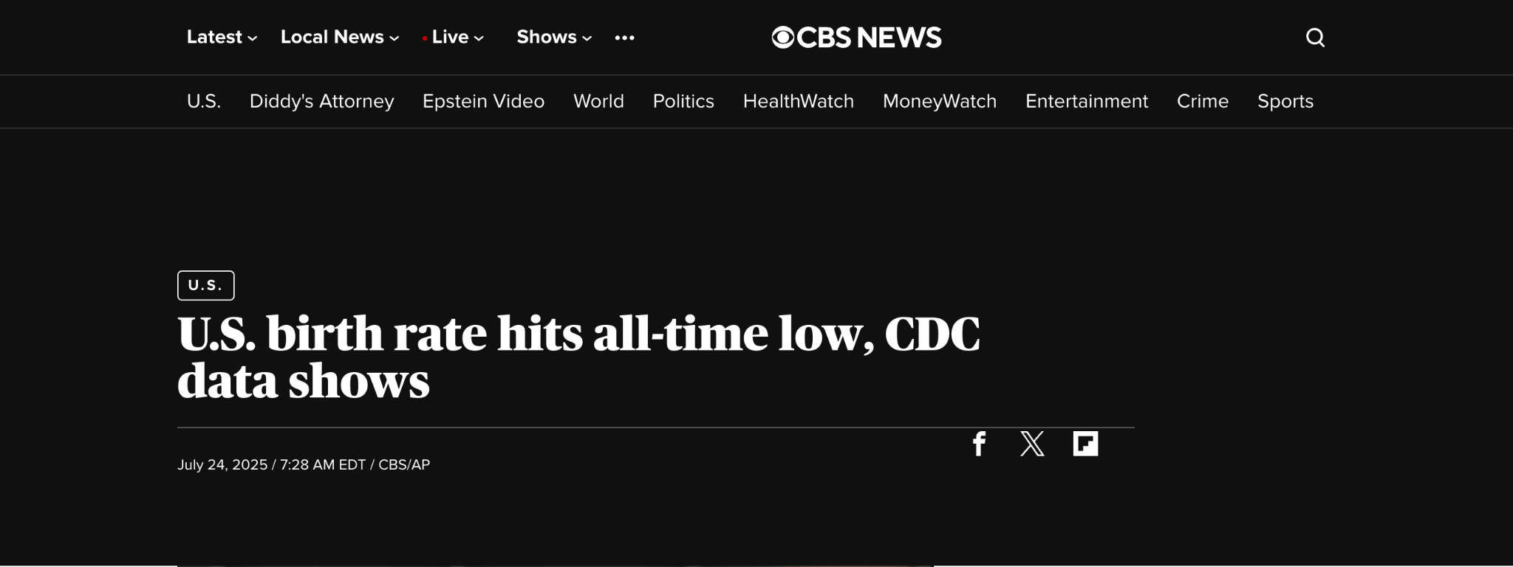
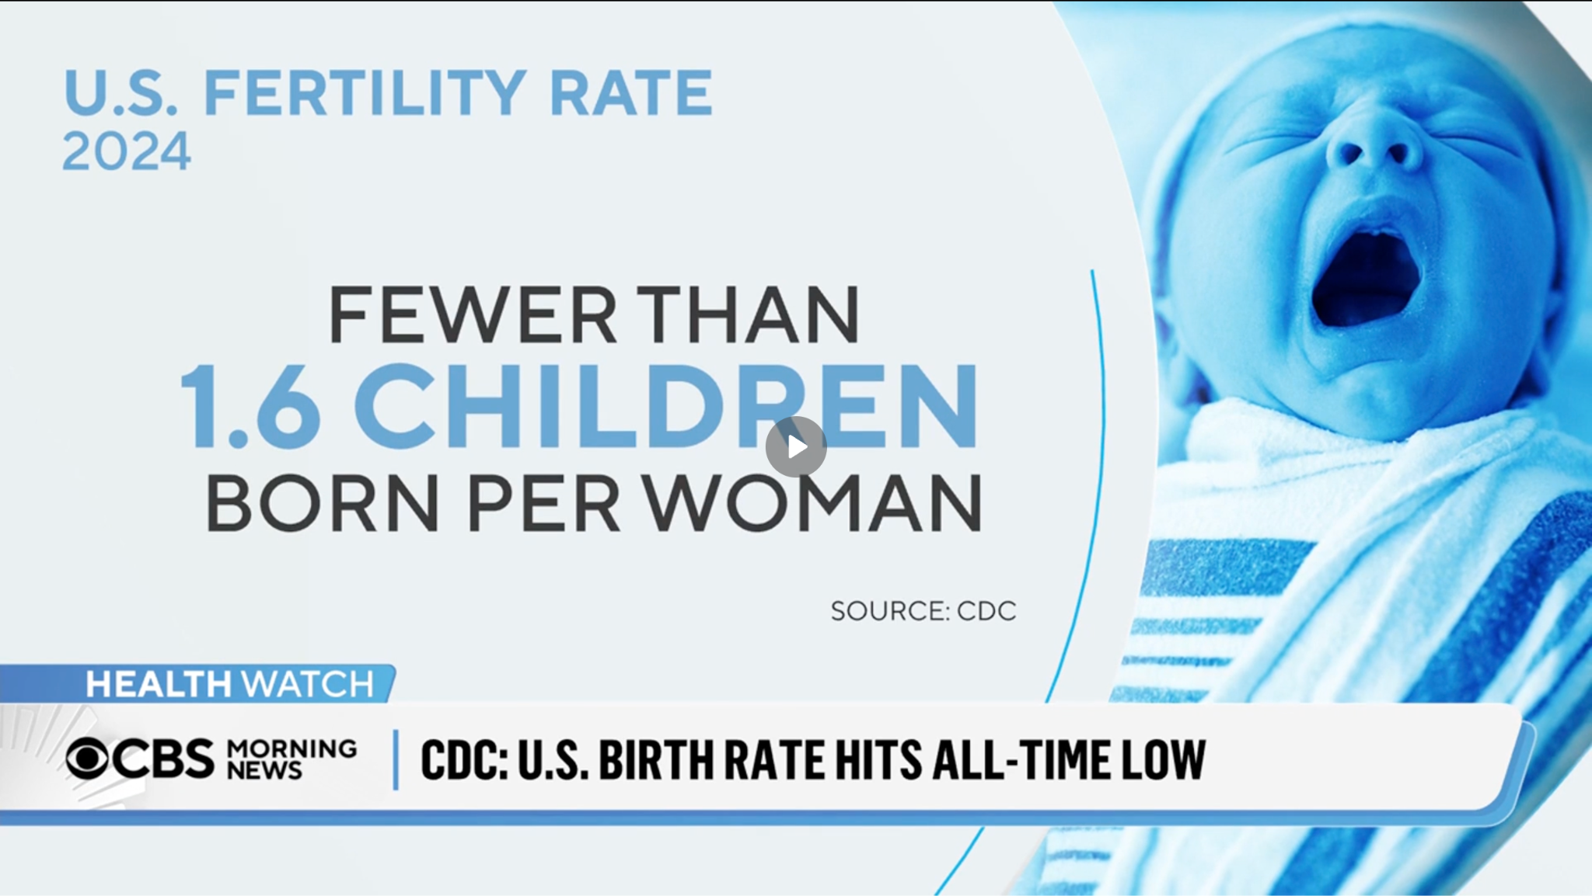
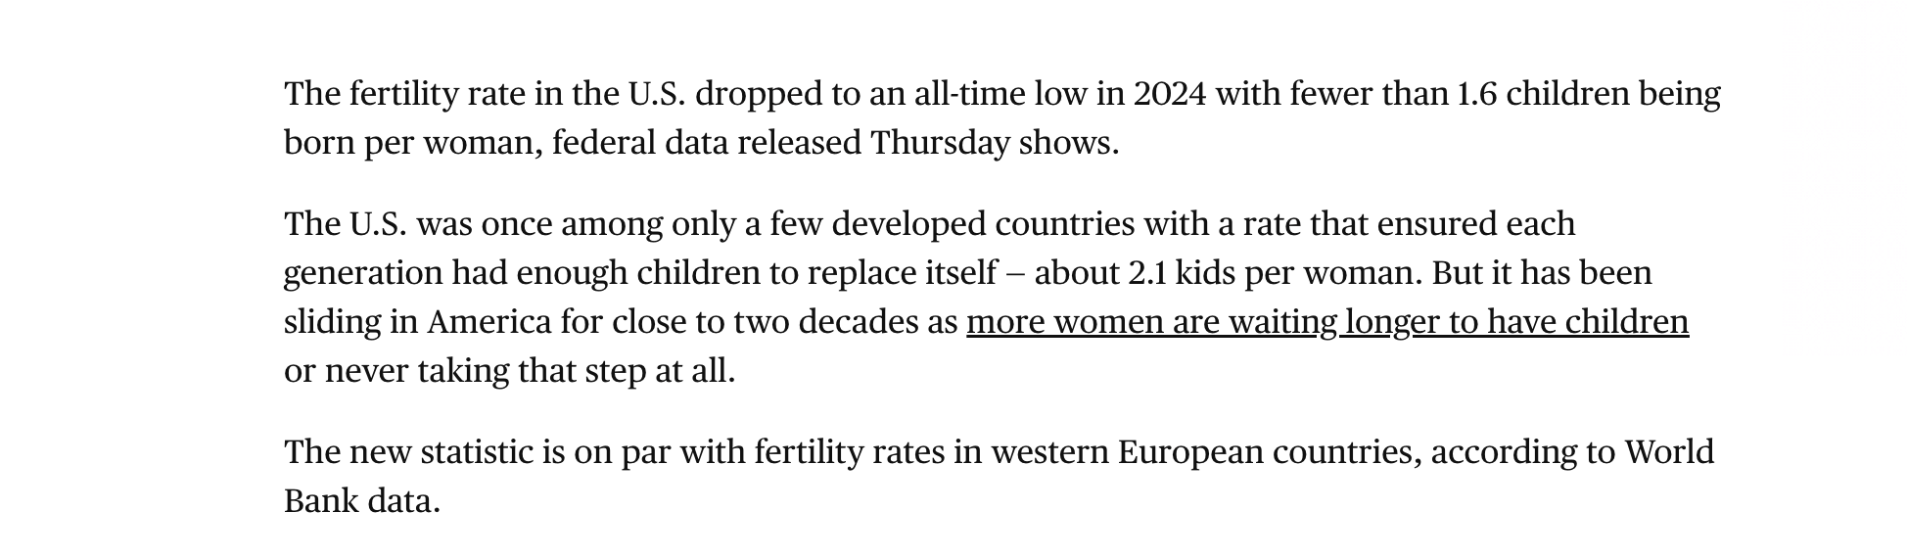
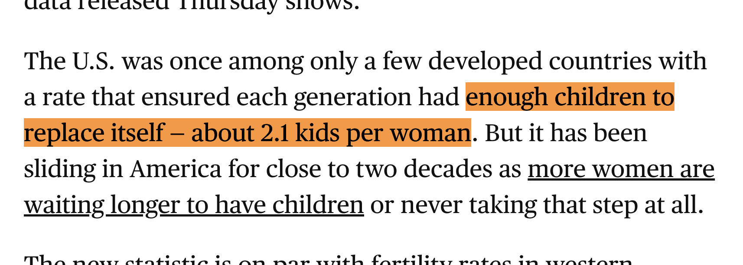
Notes:
In 2024, the U.S. total fertility rate fell to an all-time low - under 1.6 children per woman.
Demographers estimate that a total fertility rate of approximately 2.1 births per woman is required to sustain a stable population in developed countries, accounting for child mortality and other demographic factors

Slide 4

01
PROJECT GOALS
Examine U.S. Newborn Population Reduction
Uncover Key Characteristics of Underlying Issues
How Can We Overcome & Prevent the Decline of Our Birth Rate?
Notes:
In this project, we take on quantitative approach rather than a social-economic one to possibly investigate and aid the issue.
examine the recent decline in the U.S. newborn population, seeking to identify the root causes by leveraging machine learning algorithms
Our objective is to uncover key characteristics of the underlying issue
Leading us to our problem statement: How can we overcome and prevent the decline of U.S. birth rate?

Slide 5

02
DATA COLLECTION

Slide 6




Our Main Source: IPUMS (Integrated Public Use Microdata Series)
The gold standard for individual-level US census data.
Allows us to track historical demographic and socio-economic trends.
Supporting Sources:
National Center for Health Statistics (NCHS) for detailed fertility data.
Pew Research Center for broader social and cultural insights.
Why this approach?
Moving beyond aggregate numbers to understand individual-level decisions.
Ensures a comprehensive and robust analysis.
Gathering the Clues: Our Data & Why It Matters

Slide 7
From the Crowd to the Core: Feature Selection
01
Raw Data: Started with a rich dataset containing a multitude of features
(e.g., YEAR, INCOME_TOTAL, MARITAL_STATUS, EDUCATION, etc.).
02
Our Focus: We honed in on 18 key features to build our model, carefully chosen to reflect a woman's standpoint.
The size of the dataset: 3.4 mil to 763,262 records!!!
Key Feature Groups
Demographics
Socio-economic
Family Status
Health
AGE, gave_birth_12mo, above_2child, PERSON_WEIGHT
HOUSEHOLD_INCOME, employed, education_years
ever_married, num_times_married, years_since_marriage, moved_last_year
has_insurance

Slide 8

03
EXPLORATORY DATA ANALYSIS

Slide 9
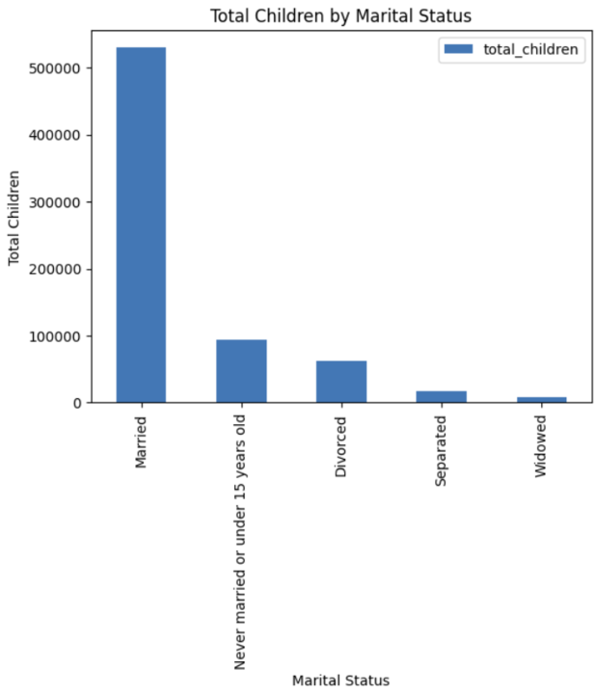
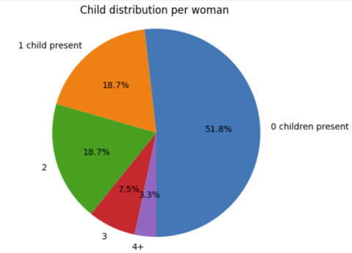
Collected from US woman in 2023
Notes:
Above 2+ is 30% of data

Slide 10
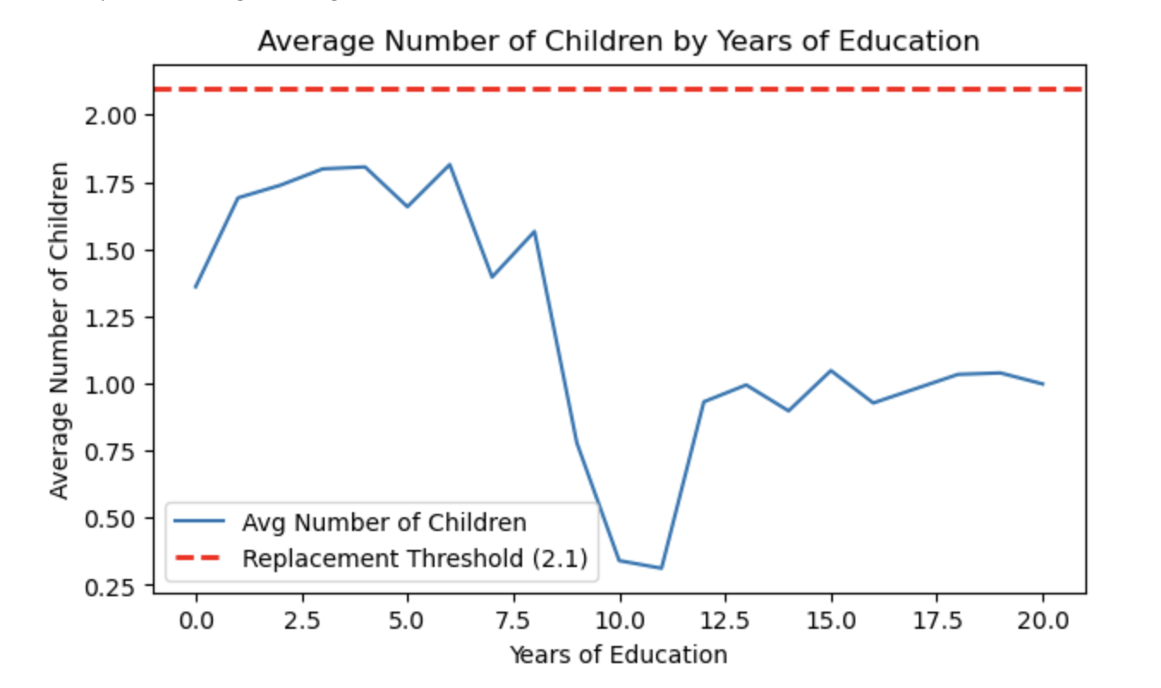

Slide 11

04
MODELING APPROACH

Slide 12
RESEARCH QUESTION
FEATURE ENGINEERING
01
“How can we predict whether a woman will have 2 or more children? What factors drive this decision?”
→ Population Replacement Goal: 2.1
02
ever_married
years_since_marriage
education_years
gave_birth_12mo
employed
age
weight
household_income
has_insurance
moved_last_year

Slide 13
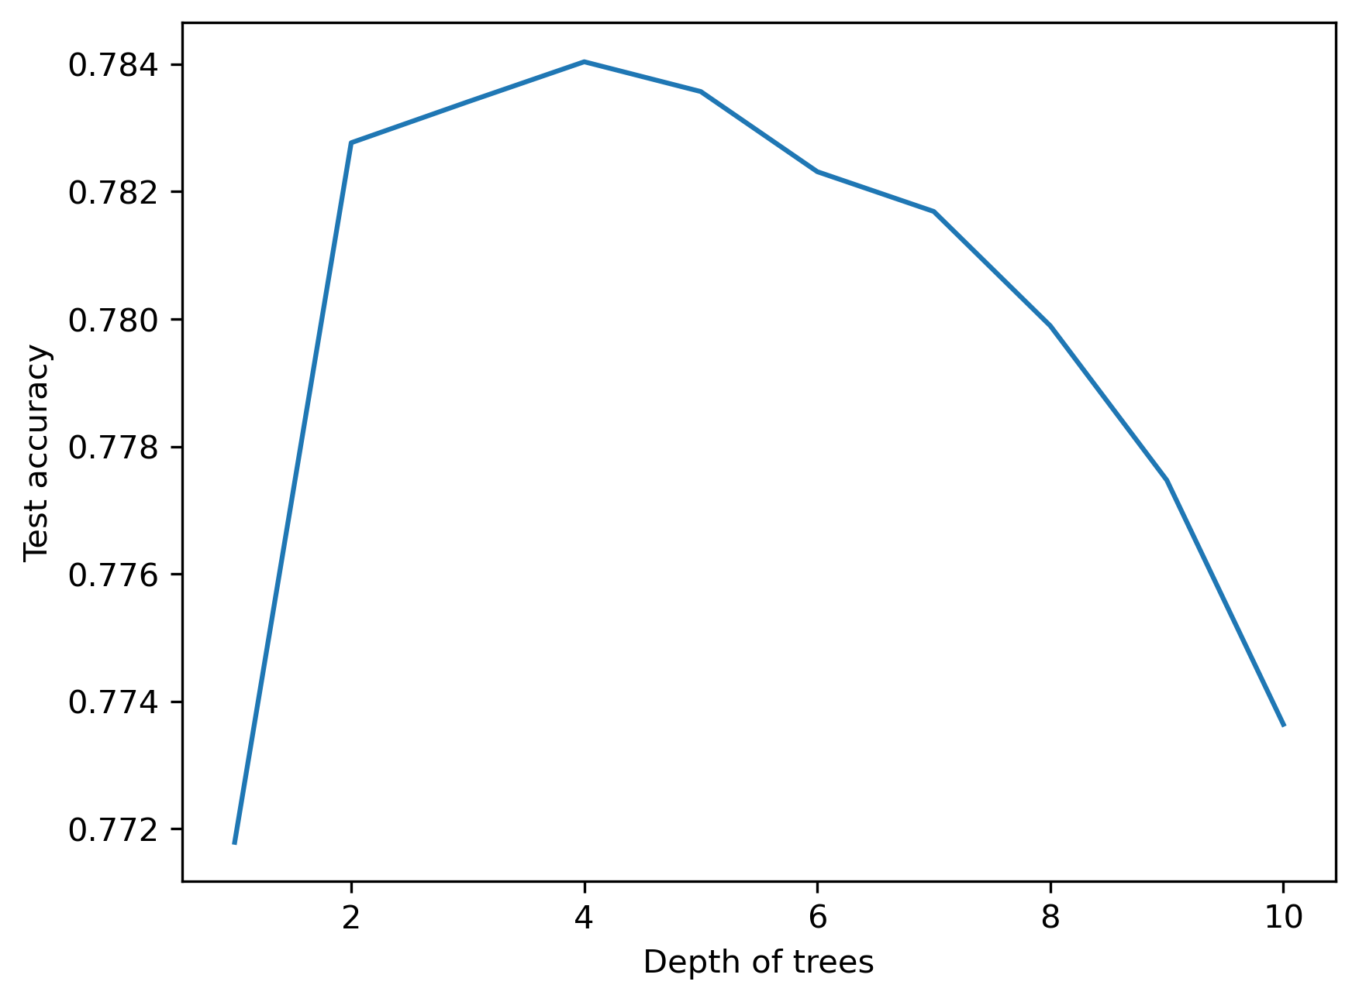
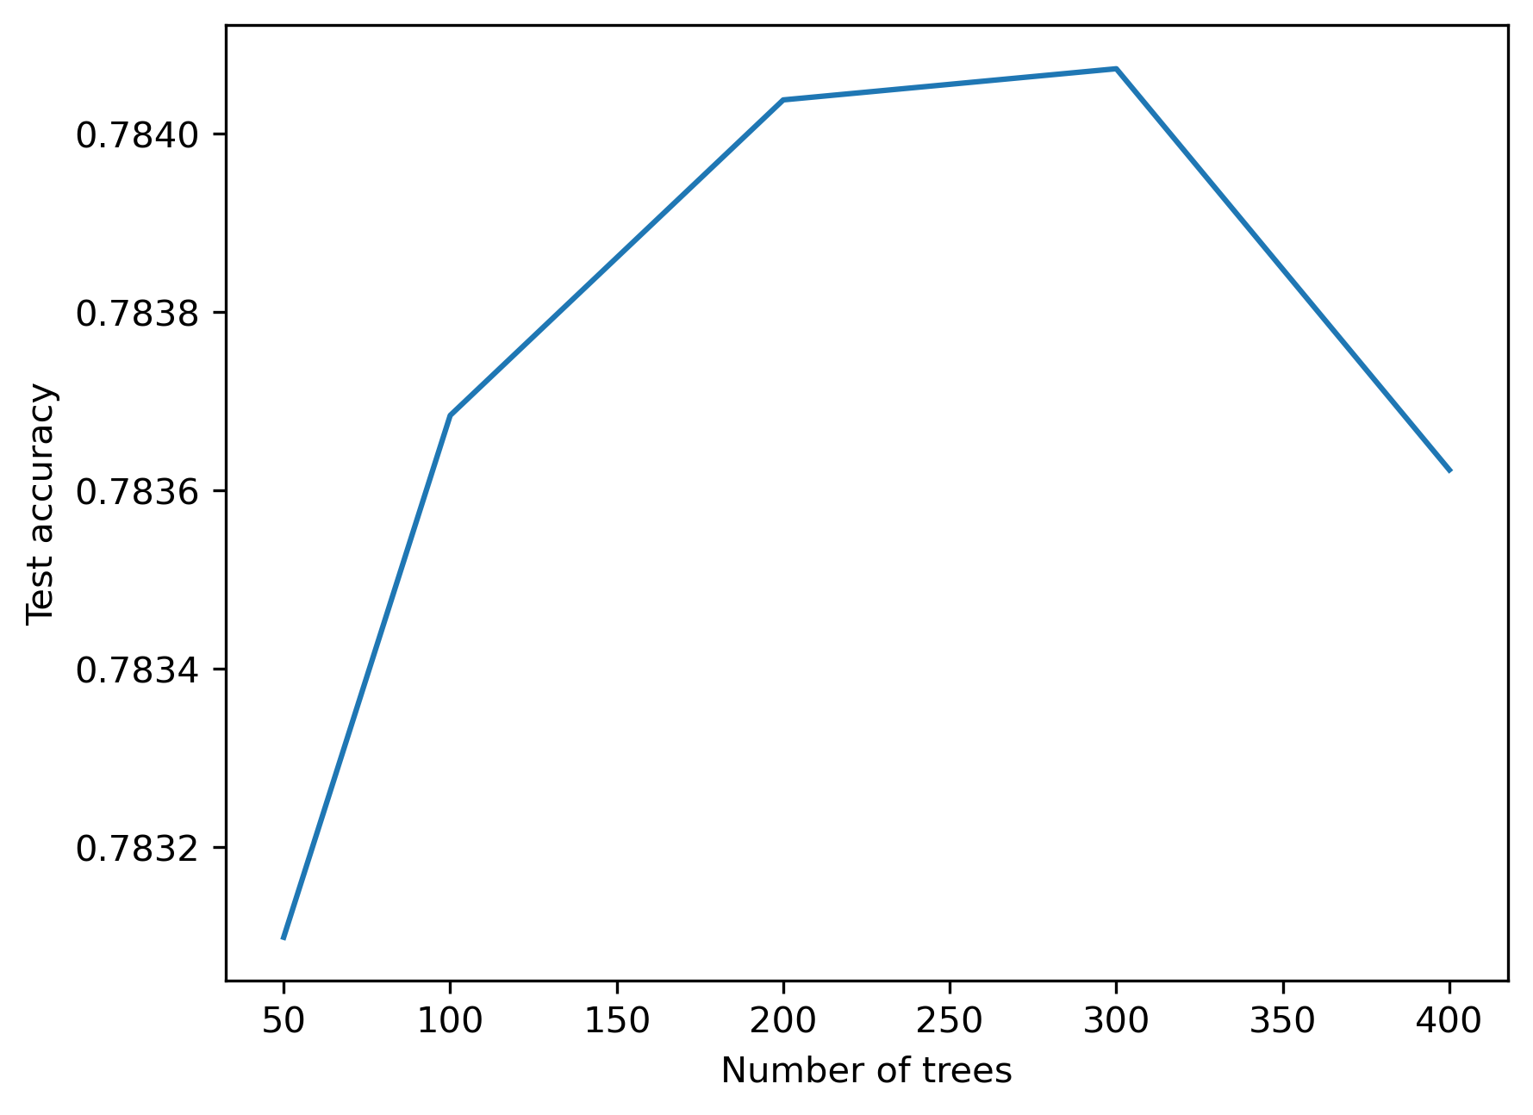
CLASSIFICATION MODELS
FINE-TUNING PARAMETERS
03
Model 1: Logistic Regression
Max iterations = 10,000 → Converged at ~7,000
Interpretable coefficients
Model 2: XGBoost Classifier
max_depth = 4
n_estimators = 200
Captures nonlinear interactions
max_depth
n_estimators
04

Slide 14
Model Result
Data
Feature Engineer
LG & XGBoost
71%
29.50%
Logistic Regression Test Accuracy
78%
Baseline Accuracy
XGBoost Classifier Test Accuracy
False Positive Rate
= 13%

Slide 15
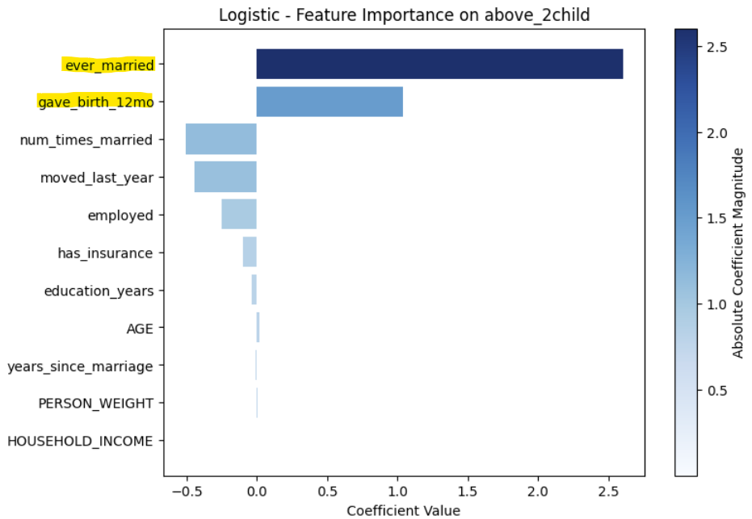
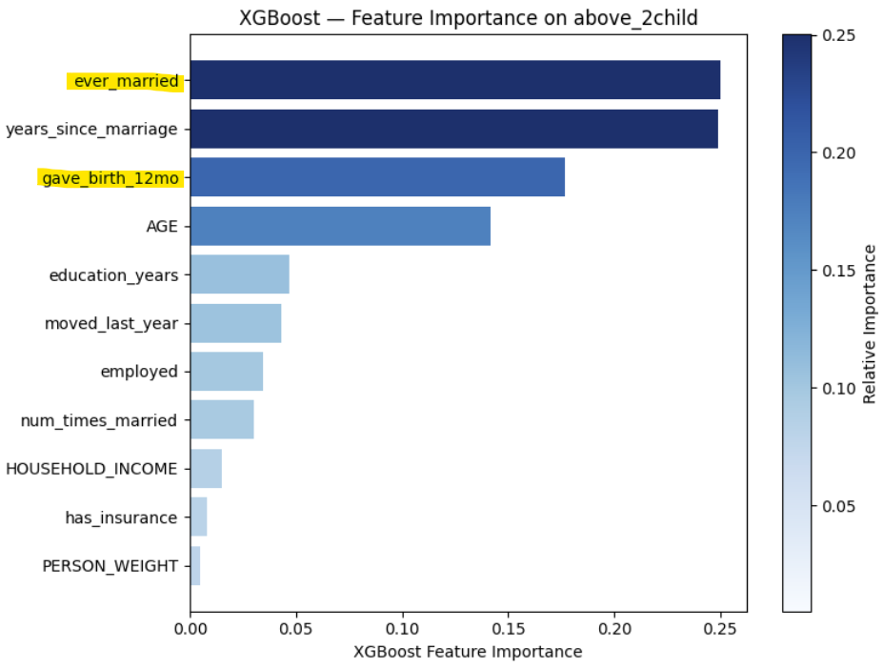
FEATURE IMPORTANCE
Logistic Regression
XGBoost Classifier

Slide 16

05
WHAT SHOULD
WE DO?

Slide 17
Odds of 2+ children increases:
Stable marriage
1st child birth within last year
13X
Stable marriage
3X
If 1st child is born within last year
40%
Number of marriages
22%
Employment
Notes:
We will focus on child support systems, bringing the cost down for parents.

Slide 18
Policy Measures
After Birth
Incentive for 2nd child like free day-care costs.
Monthly payouts by government to households with 2 children.
03
Before Birth
Provide full wages during maternity leave.
Encourage paternity leave within organizations.
Easy on-boarding for women on return.
01
02
At Birth
67% cost sharing by the government.
Postnatal care staffs by local healthcare staffs.
Notes:
Both government and private companies need to chip-in as a society.

Slide 19

THANK YOU
America’s Baby Bust ❌
Boom ✅

Slide 20
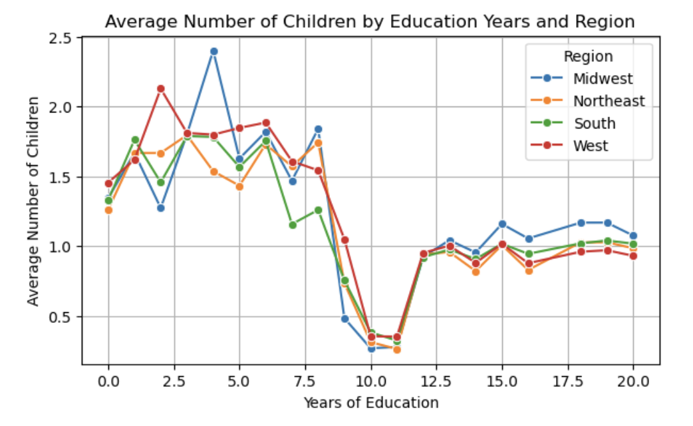
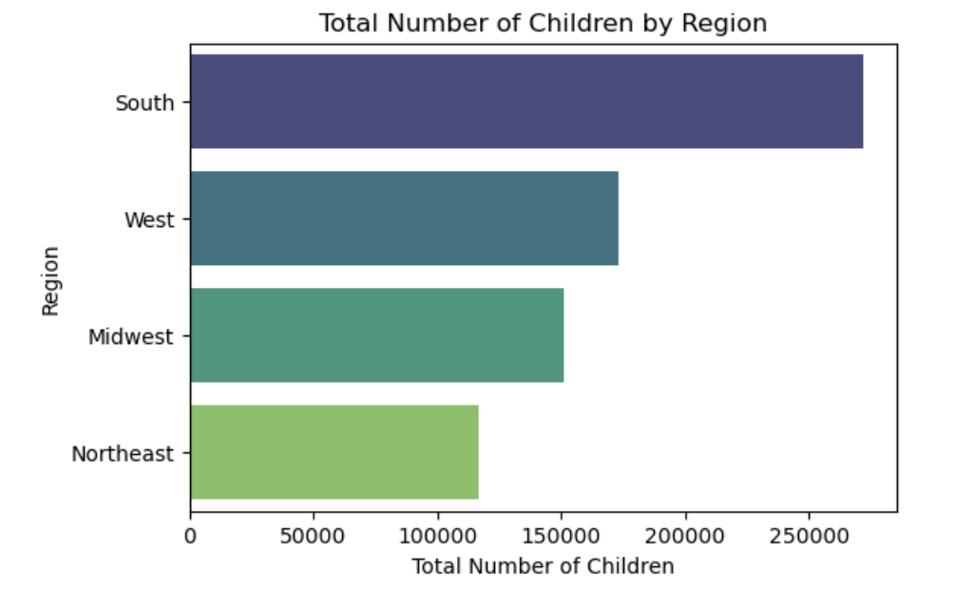
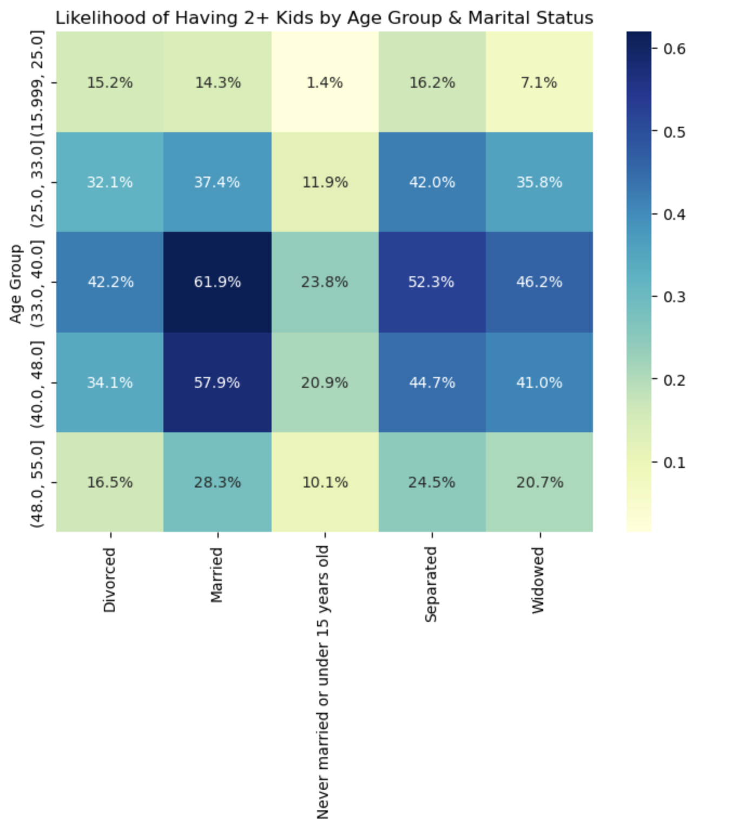
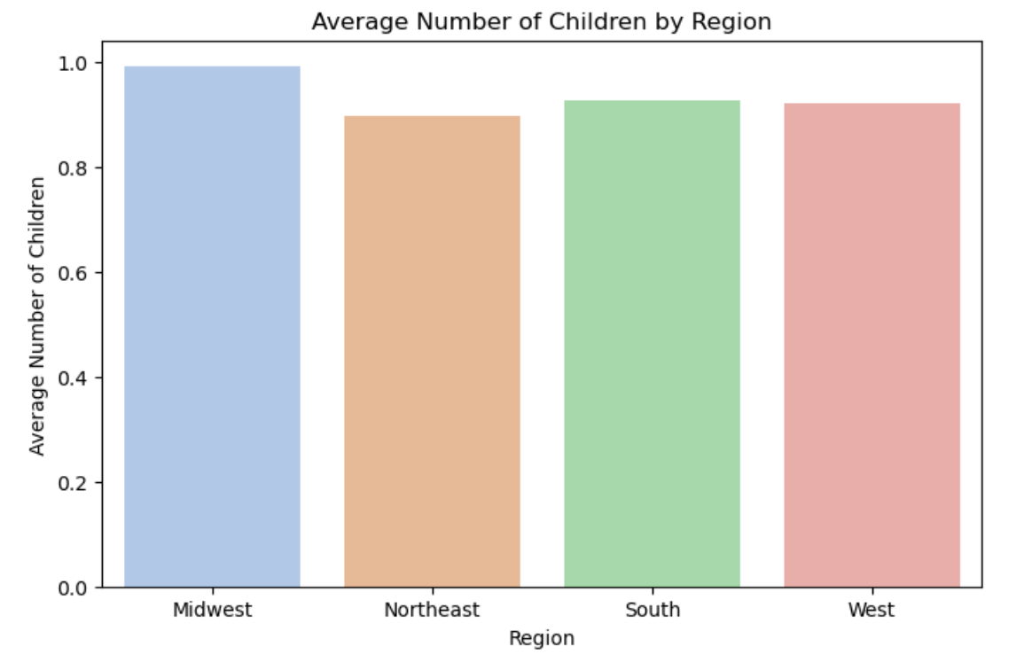
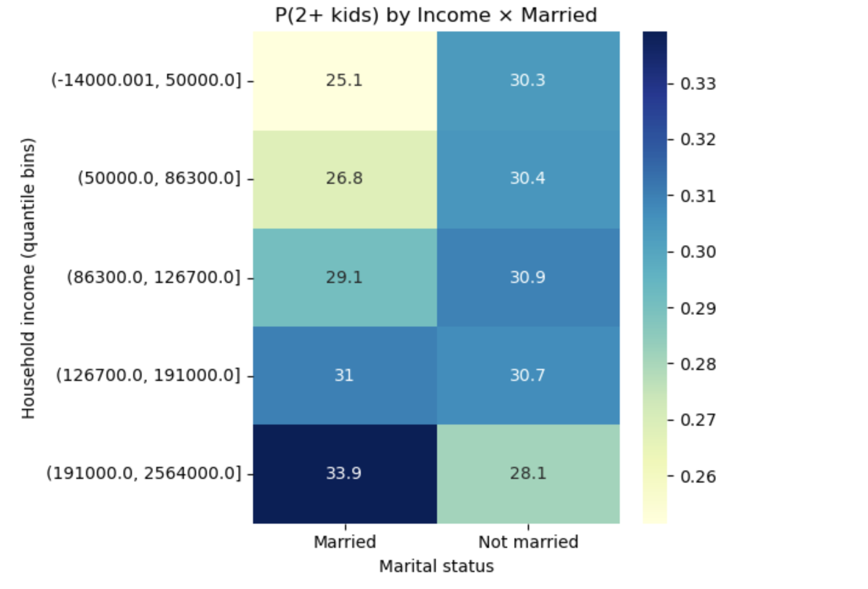
Appendix

